Slide 1
Network Flow
Data Structures and Algorithms
Nanjing University, Fall 2024
郑朝栋

Slide 2
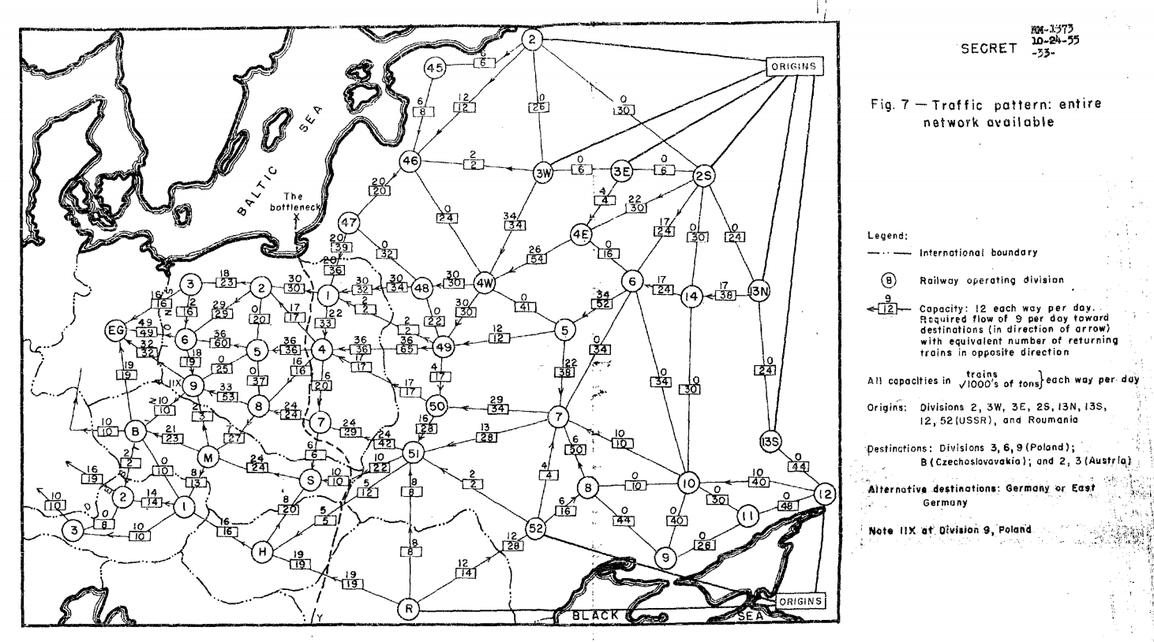
How to transport (freeze) staff
Source: https://apps.dtic.mil/dtic/tr/fulltext/u2/093458.pdf

Slide 3
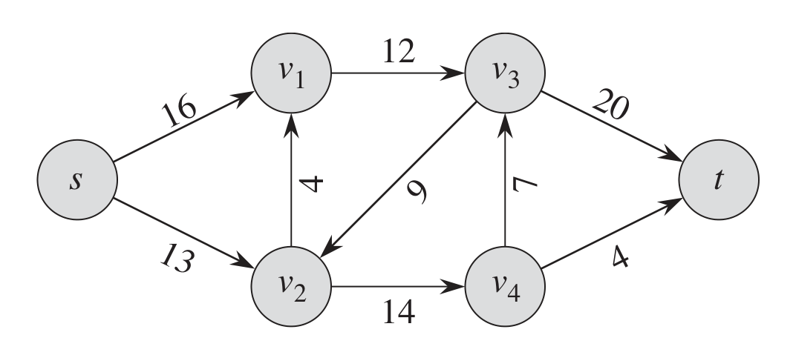
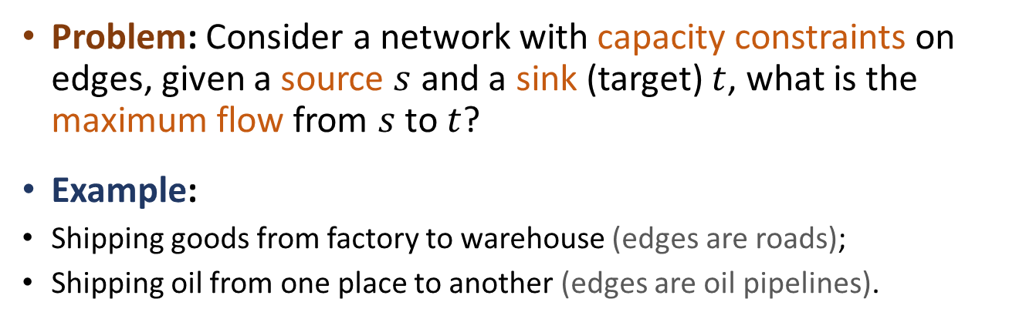
Network Flow
Problem: Consider a network with capacity constraints on edges, given a source $s$ and a sink (target) $t$, what is the maximum flow from $s$ to $t$?
Example:
Shipping goods from factory to warehouse (edges are roads);
Shipping oil from one place to another (edges are oil pipelines).

Slide 4



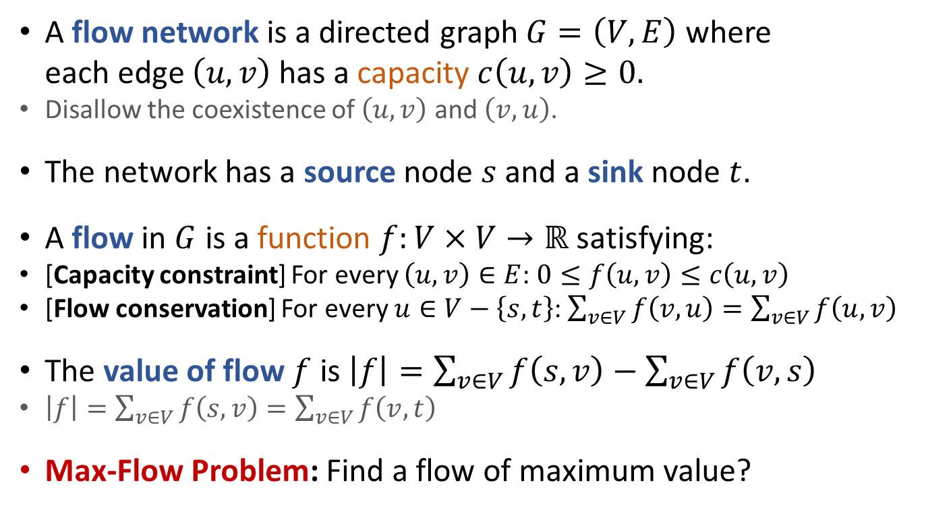



Network Flow
$$v_{1}$$
12
$$v_{3}$$
16
12
20
12
19
$$s$$
4
9
7
7
$$t$$
11
4
13
11
4
$$v_{2}$$
14
$$v_{4}$$
A flow network is a directed graph $G=\left(V,E\right)$ where each edge $\left(u,v\right)$ has a capacity $c\left(u,v\right)≥0.$
Disallow the coexistence of $\left(u,v\right)$ and $\left(v,u\right)$.
The network has a source node $s$ and a sink node $t$.
A flow in $G$ is a function $f:V×V→ℝ$ satisfying:
[Capacity constraint] For every $\left(u,v\right)∈E$: $0≤f\left(u,v\right)≤c\left(u,v\right)$
[Flow conservation] For every $u∈V−\left\{s,t\right\}$: $\sum_{v∈V}{f\left(v,u\right)}=\sum_{v∈V}{f\left(u,v\right)}$
The value of flow $f$ is $\left|f\right|=\sum_{v∈V}{f\left(s,v\right)}−\sum_{v∈V}{f\left(v,s\right)}$
$\left|f\right|=\sum_{v∈V}{f\left(s,v\right)}=\sum_{v∈V}{f\left(v,t\right)}$
Max-Flow Problem: Find a flow of maximum value?

Slide 5
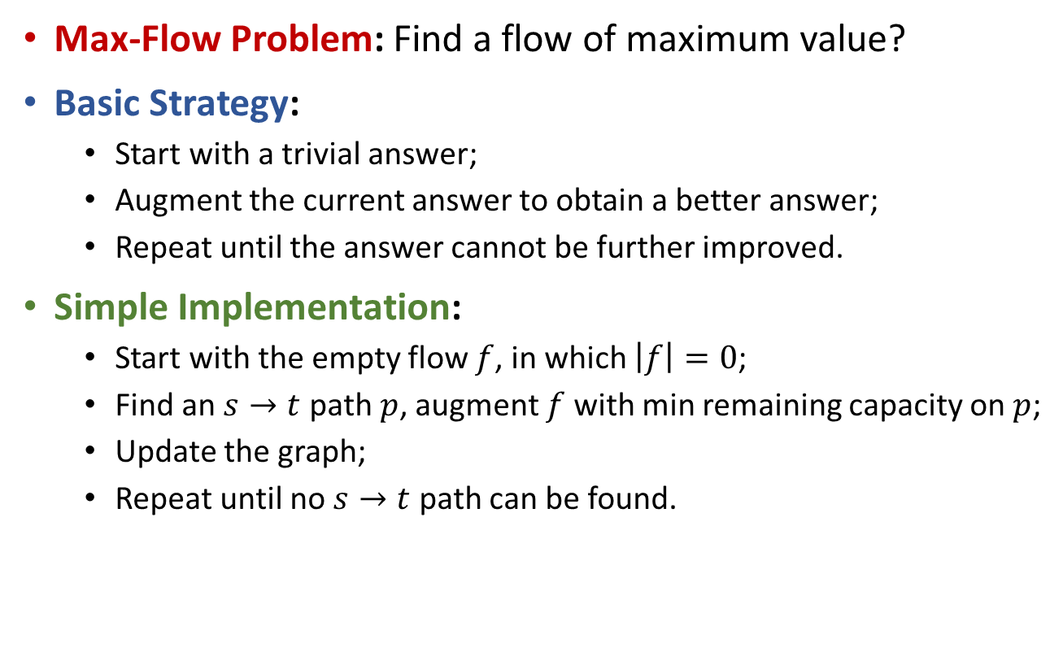
Maximum Flow
Max-Flow Problem: Find a flow of maximum value?
Basic Strategy:
Start with a trivial answer;
Augment the current answer to obtain a better answer;
Repeat until the answer cannot be further improved.
Simple Implementation:
Start with the empty flow $f$, in which $\left|f\right|=0$;
Find an $s→t$ path $p$, augment $f$ with min remaining capacity on $p$;
Update the graph;
Repeat until no $s→t$ path can be found.

Slide 6









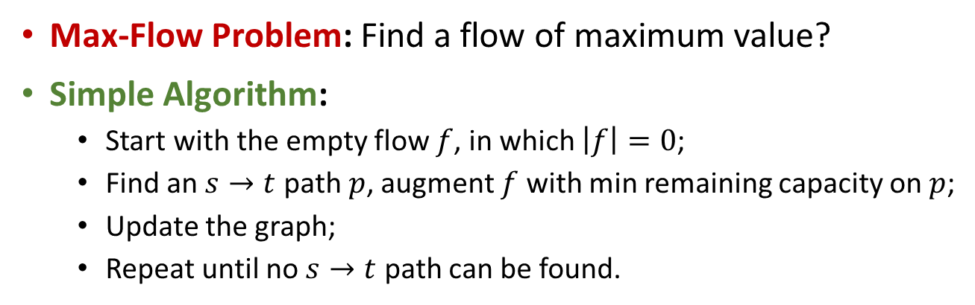







Maximum Flow
Max-Flow Problem: Find a flow of maximum value?
Simple Algorithm:
Start with the empty flow $f$, in which $\left|f\right|=0$;
Find an $s→t$ path $p$, augment $f$ with min remaining capacity on $p$;
Update the graph;
Repeat until no $s→t$ path can be found.
$$v_{1}$$
20/20
10/10
$$s$$
10/30
$$t$$
This algorithm doesn’t (always) give optimal answer.
10/10
$$v_{2}$$
20/20
$$v_{1}$$
$$v_{1}$$
$$v_{1}$$
20
10
20/20
10
10
$$s$$
30
$$t$$
$$s$$
20/30
$$t$$
$$s$$
10
$$t$$
10
$$v_{2}$$
20
10
$$v_{2}$$
20/20
10
$$v_{2}$$

Slide 7


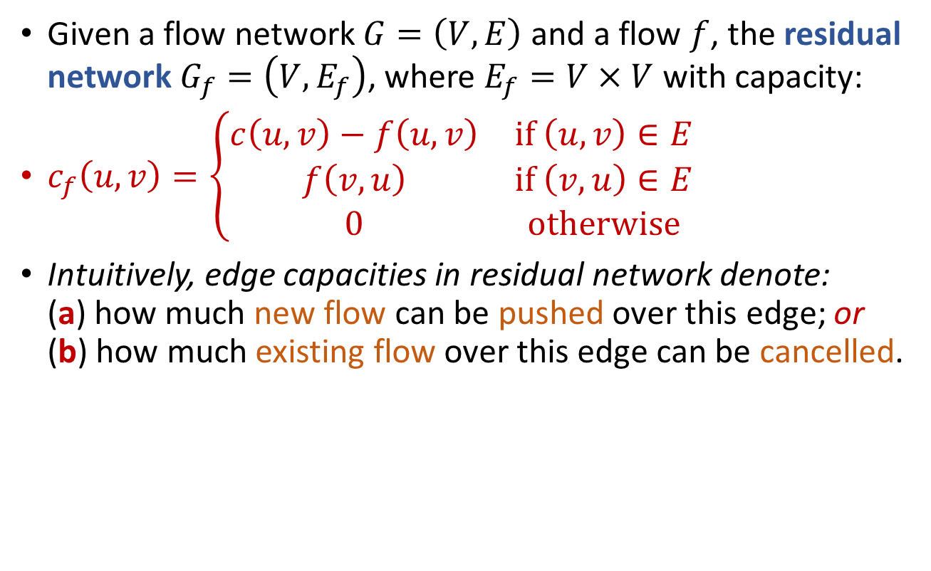


Residual Network
Given a flow network $G=\left(V,E\right)$ and a flow $f$, the residual network $G_{f}=\left(V,E_{f}\right)$, where $E_{f}=V×V$ with capacity:
$c_{f}\left(u,v\right)=\left\{\begin{matrix}c\left(u,v\right)−f\left(u,v\right) & if \left(u,v\right)∈E \\ f\left(v,u\right) & if \left(v,u\right)∈E \\ 0 & otherwise\end{matrix}\right.$
Intuitively, edge capacities in residual network denote: (a) how much new flow can be pushed over this edge; or (b) how much existing flow over this edge can be cancelled.
$$v_{1}$$
$$v_{1}$$
0
$$v_{1}$$
10
20
10
20/20
10
20
0
$$s$$
30
$$t$$
$$s$$
20/30
$$t$$
$$s$$
20
10
$$t$$
0
20
10
$$v_{2}$$
20
10
$$v_{2}$$
20/20
10
$$v_{2}$$
0

Slide 8








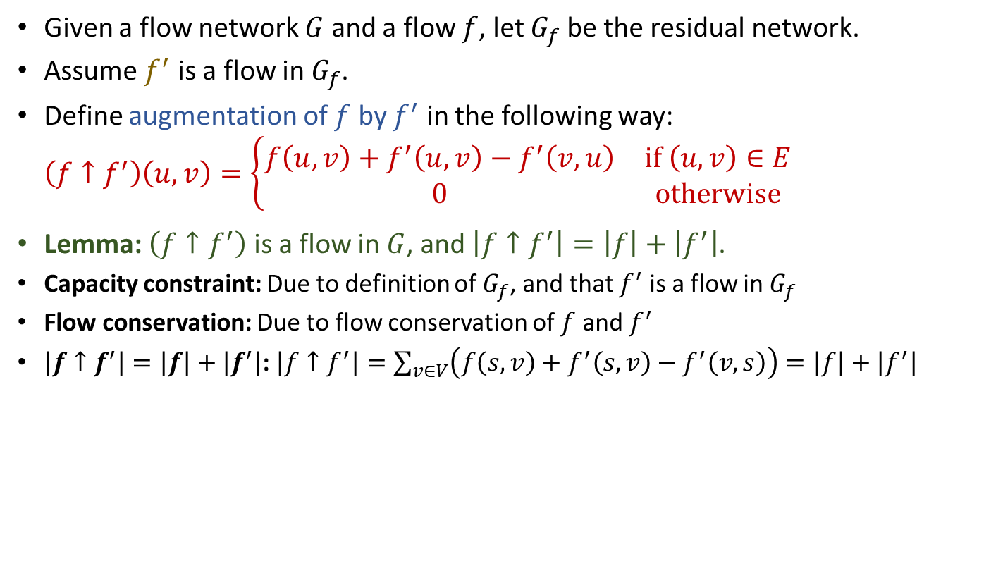











Residual Network
Given a flow network $G$ and a flow $f$, let $G_{f}$be the residual network.
Assume $f^{′}$ is a flow in $G_{f}$.
Define augmentation of $f$ by $f^{′}$ in the following way: $\left(f↑f^{′}\right)\left(u,v\right)=\left\{\begin{matrix}f\left(u,v\right)+f^{′}\left(u,v\right)−f^{′}\left(v,u\right) & if \left(u,v\right)∈E \\ 0 & otherwise\end{matrix}\right.$
Lemma: $\left(f↑f^{′}\right)$ is a flow in $G$, and $\left|f↑f^{′}\right|=\left|f\right|+\left|f^{′}\right|$.
Capacity constraint: Due to definition of $G_{f}$, and that $f^{′}$ is a flow in $G_{f}$
Flow conservation: Due to flow conservation of $f$ and $f^{′}$
$\left|f↑f^{′}\right|=\left|f\right|+\left|f^{′}\right|$: $\left|f↑f^{′}\right|=\sum_{v∈V}{\left(f\left(s,v\right)+f^{′}\left(s,v\right)−f^{′}\left(v,s\right)\right)}=\left|f\right|+\left|f^{′}\right|$
$$v_{1}$$
$$v_{1}$$
$$v_{1}$$
$$v_{1}$$
20/20
10
20
10
20/20
5/10
20
10
5/10
$$s$$
$$t$$
$$s$$
$$t$$
$$s$$
5/20
10
$$t$$
$$s$$
$$t$$
30
20/30
20
15/30
5/10
10
20
10
$$v_{2}$$
20/20
10
$$v_{2}$$
20
5/10
$$v_{2}$$
20/20
$$v_{2}$$
Flow $f$
Residual network $G_{f}$
Flow $f↑f^{′}$

Slide 9
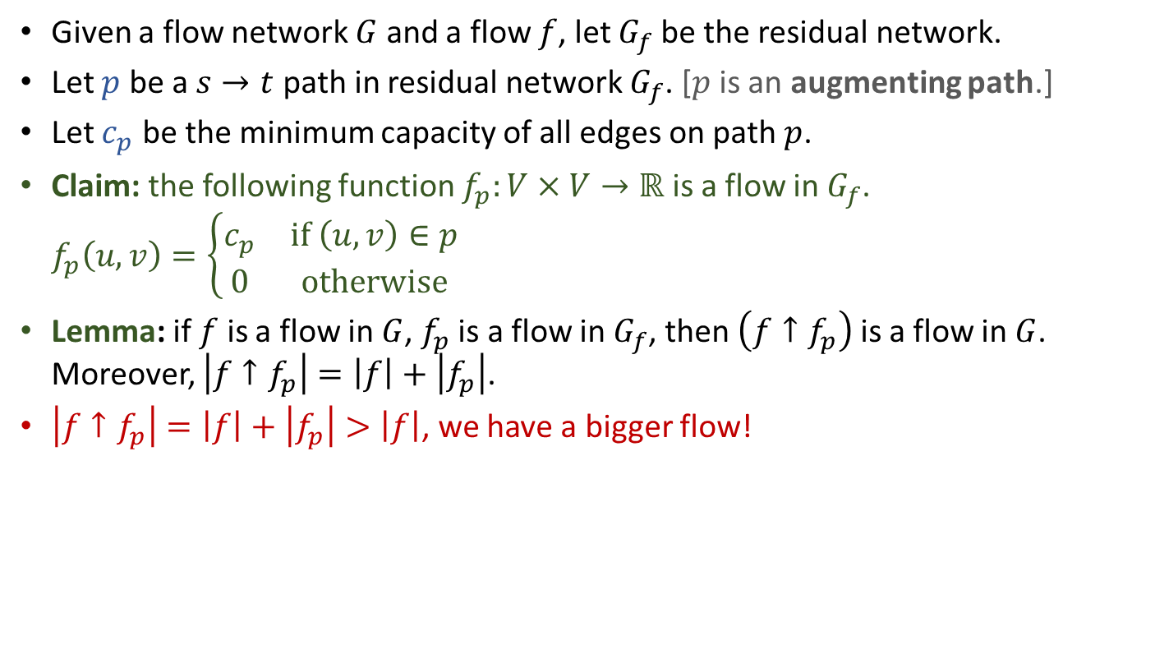
Augmenting Flow
Given a flow network $G$ and a flow $f$, let $G_{f}$be the residual network.
Let $p$ be a $s→t$ path in residual network $G_{f}$. [$p$ is an augmenting path.]
Let $c_{p}$ be the minimum capacity of all edges on path $p$.
Claim: the following function $f_{p}:V×V→ℝ$ is a flow in $G_{f}$. $f_{p}\left(u,v\right)=\left\{\begin{matrix}c_{p} & if \left(u,v\right)∈p \\ 0 & otherwise\end{matrix}\right.$
Lemma: if $f$ is a flow in $G$, $f_{p}$ is a flow in $G_{f}$, then $\left(f↑f_{p}\right)$ is a flow in $G$. Moreover, $\left|f↑f_{p}\right|=\left|f\right|+\left|f_{p}\right|$.
$\left|f↑f_{p}\right|=\left|f\right|+\left|f_{p}\right|>\left|f\right|$, we have a bigger flow!
$$v_{1}$$
$$v_{1}$$
$$v_{1}$$
$$v_{1}$$
20/20
10
20
10
20/20
10/10
20
10
10/10
$$s$$
$$t$$
$$s$$
$$t$$
$$s$$
10/20
10
$$t$$
$$s$$
$$t$$
30
20/30
20
10/30
10/10
10
20
10
$$v_{2}$$
20/20
10
$$v_{2}$$
20
10/10
$$v_{2}$$
20/20
$$v_{2}$$
Flow $f$
Residual network $G_{f}$
Flow $f↑f^{′}$

Slide 10






























Maximum Flow Ford-Fulkerson Algorithm
FordFulkersonMaxFlow(G,s,t):
Initialize flow f to value 0
while (there is an augmenting path p in G_{f})
Augment flow f along path p
return f
Residual network.
Augmenting path (in $G_{f}$).
Augmented flow (in $G$).
$$v_{1}$$
$$v_{1}$$
$$v_{1}$$
$$v_{1}$$
20
10
20
10
20/20
10
20/20
10
Upon termination, the Ford-Fulkerson algorithm finds a maximum flow.
$$s$$
30
$$t$$
$$s$$
30
$$t$$
$$s$$
20/30
$$t$$
$$s$$
20/30
$$t$$
10
$$v_{2}$$
20
10
$$v_{2}$$
20
10
$$v_{2}$$
20/20
10
20/20
$$v_{2}$$
$$v_{1}$$
$$v_{1}$$
$$v_{1}$$
20
10
20
10/10
20/20
10/10
$$s$$
20
10
$$t$$
$$s$$
10/20
10
$$t$$
$$s$$
10/30
$$t$$
10
$$v_{2}$$
20
10/10
$$v_{2}$$
20
10/10
$$v_{2}$$
20/20

Slide 11
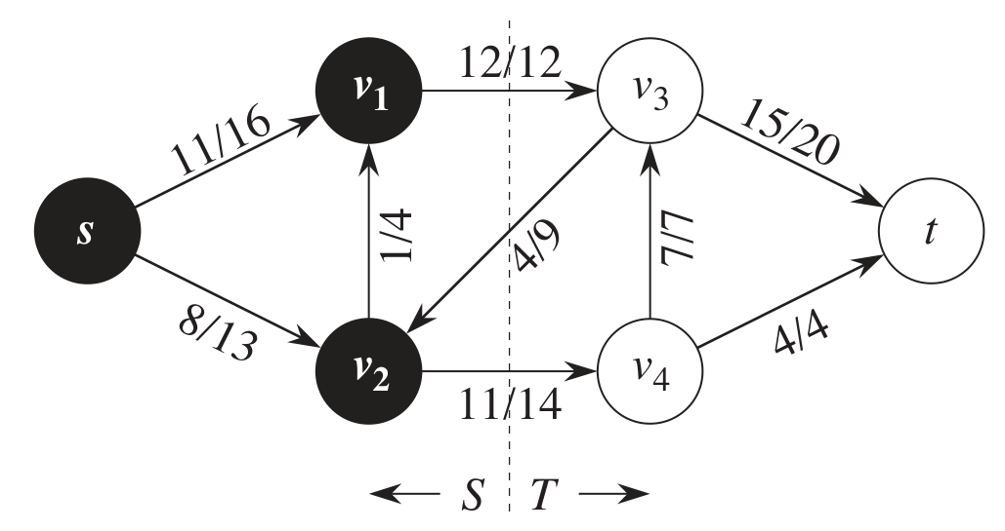
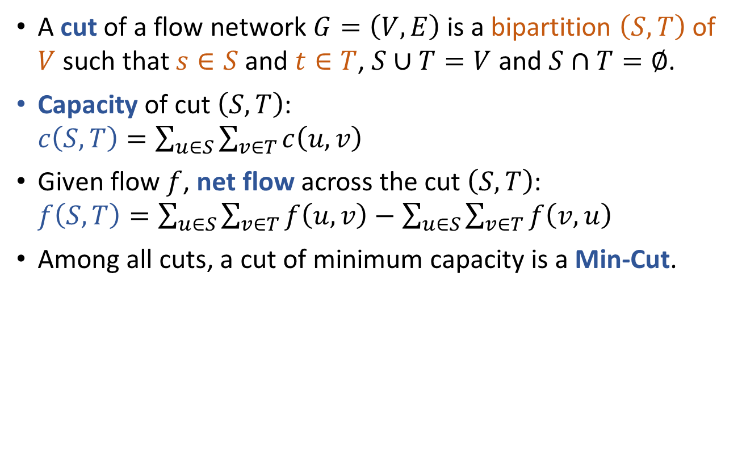
Cuts
A cut of a flow network $G=\left(V,E\right)$ is a bipartition $\left(S,T\right)$ of $V$ such that $s∈S$ and $t∈T$, $S∪T=V$ and $S∩T=∅$.
Capacity of cut $\left(S,T\right)$: $c\left(S,T\right)=\sum_{u∈S}{\sum_{v∈T}{c\left(u,v\right)}}$
Given flow $f$, net flow across the cut $\left(S,T\right)$: $f\left(S,T\right)=\sum_{u∈S}{\sum_{v∈T}{f\left(u,v\right)}}−\sum_{u∈S}{\sum_{v∈T}{f\left(v,u\right)}}$
Among all cuts, a cut of minimum capacity is a Min-Cut.
Capacity of the cut is 12+14=26.
Net flow across the cut is 12+11-4=19.

Slide 12
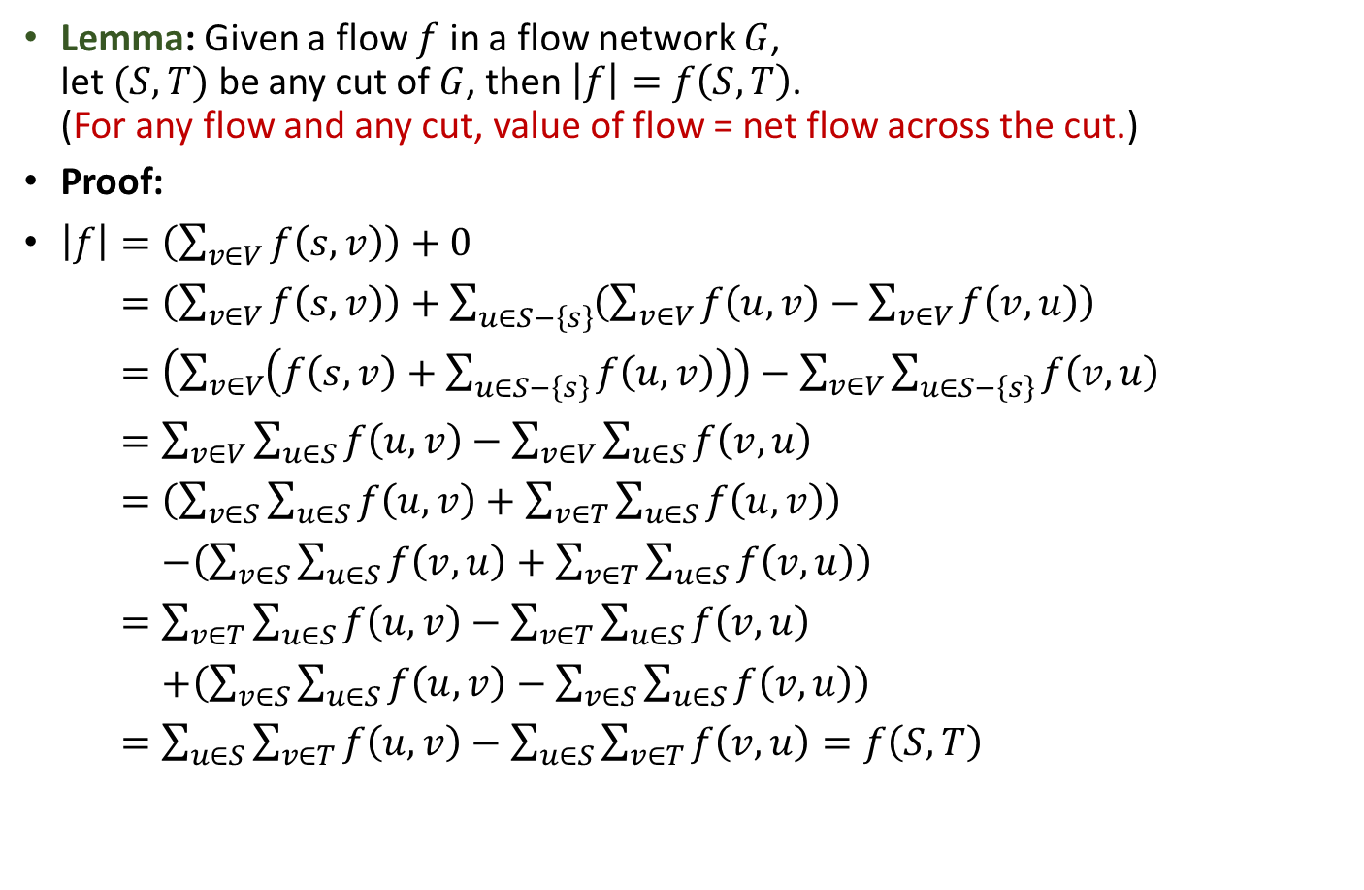
Cuts
Lemma: Given a flow $f$ in a flow network $G$, let $(S,T)$ be any cut of $G$, then $\left|f\right|=f\left(S,T\right)$. (For any flow and any cut, value of flow = net flow across the cut.)
Proof:
$\left|f\right|=\left(\sum_{v∈V}{f\left(s,v\right)}\right)+0$
$\left|f\right|=\left(\sum_{v∈V}{f\left(s,v\right)}\right)+\sum_{u∈S−\left\{s\right\}}{\left(\sum_{v∈V}{f\left(u,v\right)}−\sum_{v∈V}{f\left(v,u\right)}\right)}$
$\left|f\right|=\left(\sum_{v∈V}{\left(f\left(s,v\right)+\sum_{u∈S−\left\{s\right\}}{f\left(u,v\right)}\right)}\right)−\sum_{v∈V}{\sum_{u∈S−\left\{s\right\}}{f\left(v,u\right)}}$
$\left|f\right|=\sum_{v∈V}{\sum_{u∈S}{f\left(u,v\right)}}−\sum_{v∈V}{\sum_{u∈S}{f\left(v,u\right)}}$
$\left|f\right|=\left(\sum_{v∈S}{\sum_{u∈S}{f\left(u,v\right)}}+\sum_{v∈T}{\sum_{u∈S}{f\left(u,v\right)}}\right)$
$\left|f\right|=−\left(\sum_{v∈S}{\sum_{u∈S}{f\left(v,u\right)}}+\sum_{v∈T}{\sum_{u∈S}{f\left(v,u\right)}}\right)$
$\left|f\right|=\sum_{v∈T}{\sum_{u∈S}{f\left(u,v\right)}}−\sum_{v∈T}{\sum_{u∈S}{f\left(v,u\right)}}$
$\left|f\right|=+\left(\sum_{v∈S}{\sum_{u∈S}{f\left(u,v\right)}}−\sum_{v∈S}{\sum_{u∈S}{f\left(v,u\right)}}\right)$
$\left|f\right|=\sum_{u∈S}{\sum_{v∈T}{f\left(u,v\right)}}−\sum_{u∈S}{\sum_{v∈T}{f\left(v,u\right)}}=f\left(S,T\right)$

Slide 13
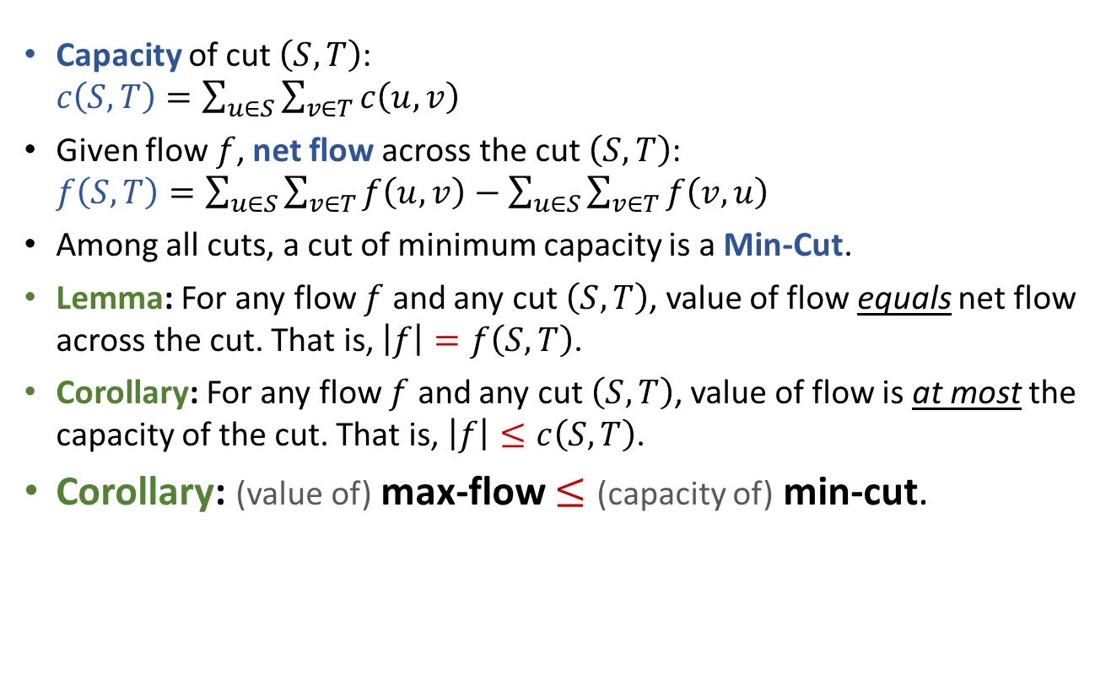
Flows and Cuts
Capacity of cut $\left(S,T\right)$: $c\left(S,T\right)=\sum_{u∈S}{\sum_{v∈T}{c\left(u,v\right)}}$
Given flow $f$, net flow across the cut $\left(S,T\right)$: $f\left(S,T\right)=\sum_{u∈S}{\sum_{v∈T}{f\left(u,v\right)}}−\sum_{u∈S}{\sum_{v∈T}{f\left(v,u\right)}}$
Among all cuts, a cut of minimum capacity is a Min-Cut.
Lemma: For any flow $f$ and any cut $\left(S,T\right)$, value of flow equals net flow across the cut. That is, $\left|f\right|=f\left(S,T\right)$.
Corollary: For any flow $f$ and any cut $\left(S,T\right)$, value of flow is at most the capacity of the cut. That is, $\left|f\right|≤c\left(S,T\right)$.
Corollary: (value of) max-flow $≤$ (capacity of) min-cut.
In fact, Max-Flow = Min-Cut.

Slide 14
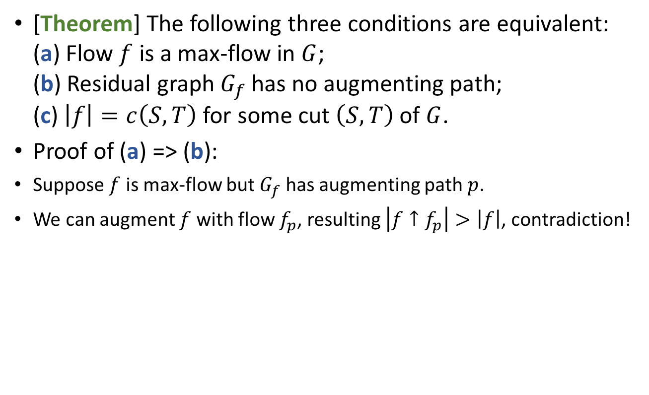
The Max-flow Min-cut Theorem
[Theorem] The following three conditions are equivalent: (a) Flow $f$ is a max-flow in $G$; (b) Residual graph $G_{f}$ has no augmenting path; (c) $\left|f\right|=c\left(S,T\right)$ for some cut $\left(S,T\right)$ of $G$.
Proof of (a) => (b):
Suppose $f$ is max-flow but $G_{f}$ has augmenting path $p$.
We can augment $f$ with flow $f_{p}$, resulting $\left|f↑f_{p}\right|>\left|f\right|$, contradiction!

Slide 15
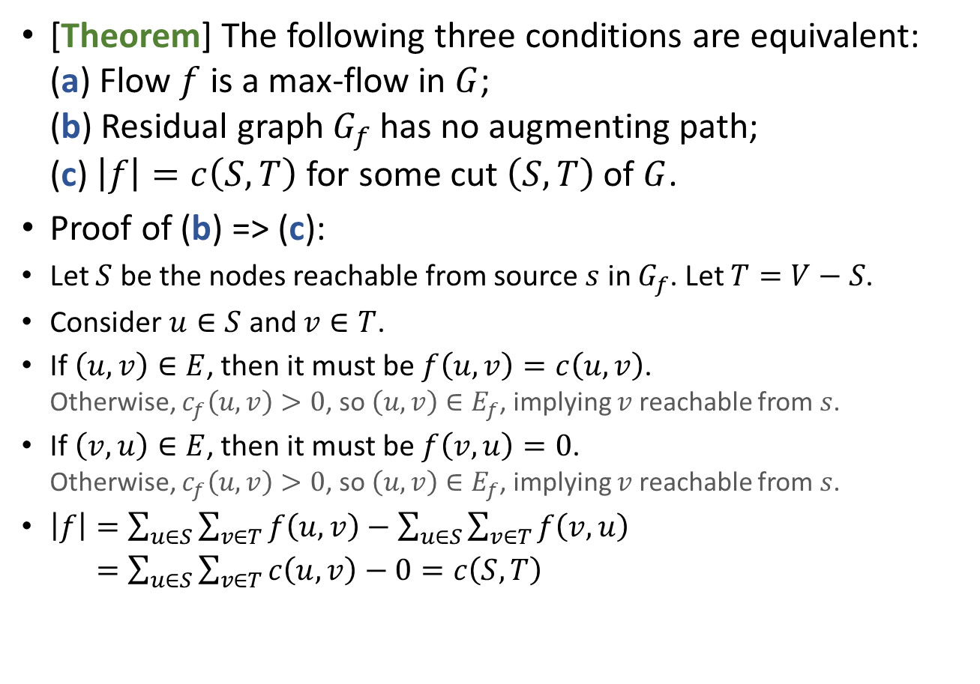
The Max-flow Min-cut Theorem
[Theorem] The following three conditions are equivalent: (a) Flow $f$ is a max-flow in $G$; (b) Residual graph $G_{f}$ has no augmenting path; (c) $\left|f\right|=c\left(S,T\right)$ for some cut $\left(S,T\right)$ of $G$.
Proof of (b) => (c):
Let $S$ be the nodes reachable from source $s$ in $G_{f}$. Let $T=V−S$.
Consider $u∈S$ and $v∈T$.
If $\left(u,v\right)∈E$, then it must be $f\left(u,v\right)=c\left(u,v\right)$. Otherwise, $c_{f}\left(u,v\right)>0$, so $\left(u,v\right)∈E_{f}$, implying $v$ reachable from $s$.
If $\left(v,u\right)∈E$, then it must be $f\left(v,u\right)=0$. Otherwise, $c_{f}\left(u,v\right)>0$, so $\left(u,v\right)∈E_{f}$, implying $v$ reachable from $s$.
$\left|f\right|=\sum_{u∈S}{\sum_{v∈T}{f\left(u,v\right)}}−\sum_{u∈S}{\sum_{v∈T}{f\left(v,u\right)}}$
$\left|f\right|=\sum_{u∈S}{\sum_{v∈T}{c\left(u,v\right)}}−0=c\left(S,T\right)$

Slide 16
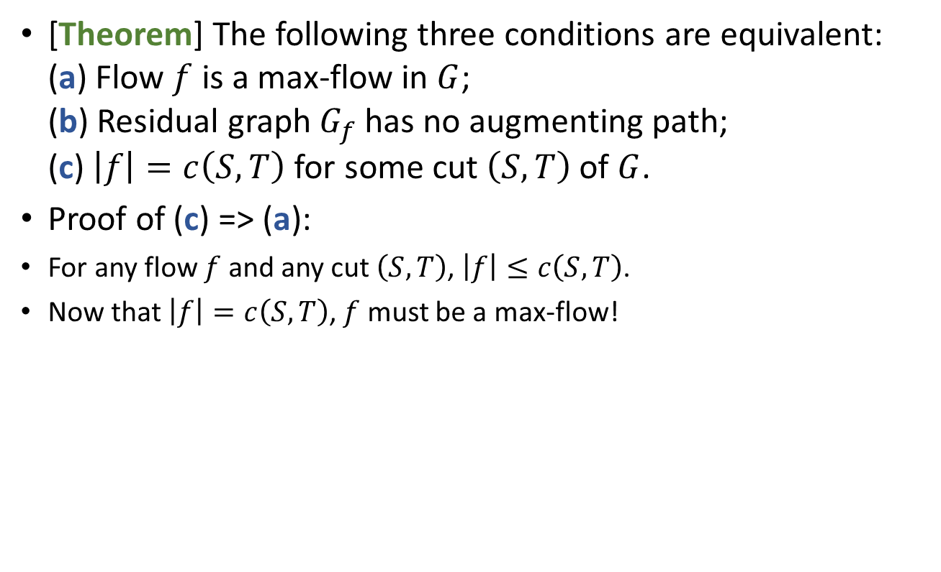
The Max-flow Min-cut Theorem
[Theorem] The following three conditions are equivalent: (a) Flow $f$ is a max-flow in $G$; (b) Residual graph $G_{f}$ has no augmenting path; (c) $\left|f\right|=c\left(S,T\right)$ for some cut $\left(S,T\right)$ of $G$.
Proof of (c) => (a):
For any flow $f$ and any cut $\left(S,T\right)$, $\left|f\right|≤c\left(S,T\right)$.
Now that $\left|f\right|=c\left(S,T\right)$, $f$ must be a max-flow!

Slide 17
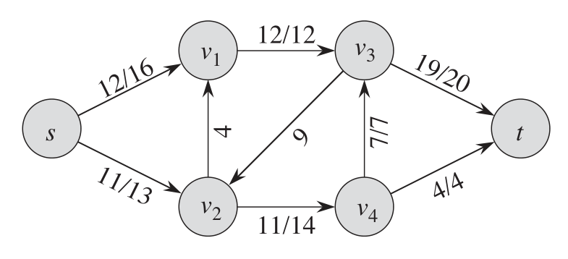
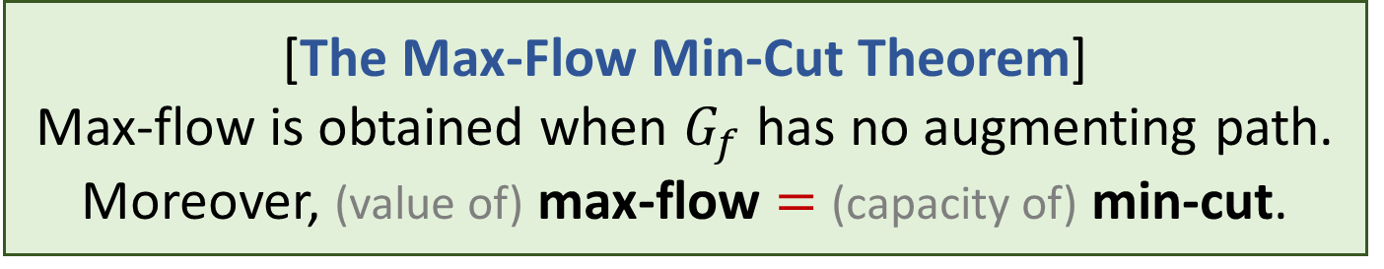
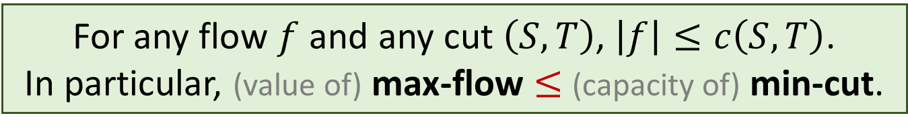
For any flow $f$ and any cut $\left(S,T\right)$, $\left|f\right|≤c\left(S,T\right)$. In particular, (value of) max-flow $≤$ (capacity of) min-cut.
[The Max-Flow Min-Cut Theorem] Max-flow is obtained when $G_{f}$ has no augmenting path. Moreover, (value of) max-flow $=$ (capacity of) min-cut.
FordFulkersonMaxFlow(G,s,t):
Initialize flow f to value 0
while (there is an augmenting path p in G_{f})
Augment flow f along path p
return f

Slide 18
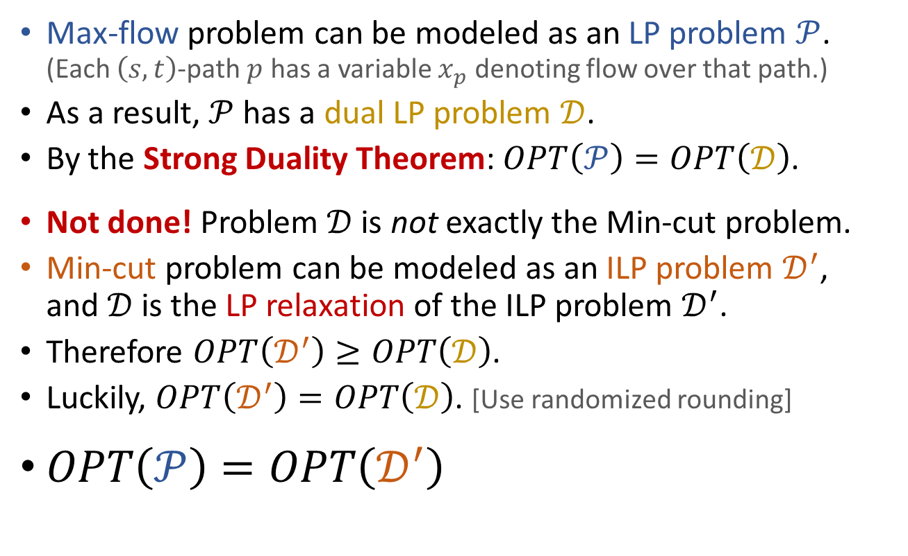
Alternative view of the Max-flow Min-cut theorem Max-Flow Min-Cut and LP Duality
Max-flow problem can be modeled as an LP problem $𝒫$. (Each $\left(s,t\right)$-path $p$ has a variable $x_{p}$ denoting flow over that path.)
As a result, $𝒫$ has a dual LP problem $𝒟$.
By the Strong Duality Theorem: $OPT\left(𝒫\right)=OPT\left(𝒟\right)$.
Not done! Problem $𝒟$ is not exactly the Min-cut problem.
Min-cut problem can be modeled as an ILP problem $𝒟^{′}$, and $𝒟$ is the LP relaxation of the ILP problem $𝒟^{′}$.
Therefore $OPT\left(𝒟^{′}\right)≥OPT\left(𝒟\right)$.
Luckily, $OPT\left(𝒟^{′}\right)=OPT\left(𝒟\right)$. [Use randomized rounding]
$OPT\left(𝒫\right)=OPT\left(𝒟^{′}\right)$

Slide 19
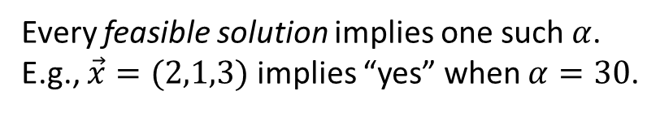
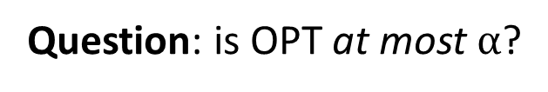
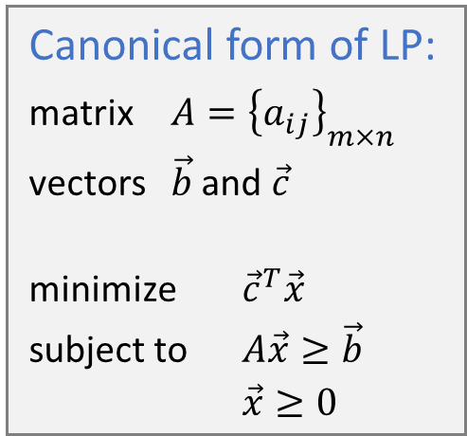
Estimate the OPT
Canonical form of LP:
matrix $A={\left\{a_{ij}\right\}}_{m×n}$
vectors $\vec{b}$ and $\vec{c}$
minimize ${\vec{c}}^{T}\vec{x}$
subject to $A\vec{x}≥\vec{b}$
$\vec{x}≥0$
minimize
subject to
Question: is OPT at most $α$?
Every feasible solution implies one such $α$.
E.g., $\vec{x}=(2,1,3)$ implies “yes” when $α=30$.

Slide 20
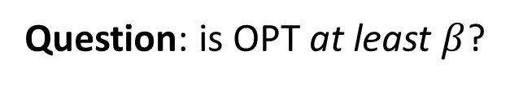


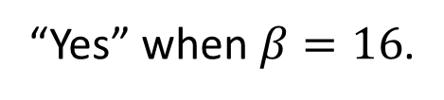




minimize
$$≥$$
subject to
$$+$$
$$+$$
$$=$$
$$16$$
Question: is OPT at least $β$?
“Yes” when $β=16$.
Question: biggest $β$ for “yes” answer ?

Slide 21




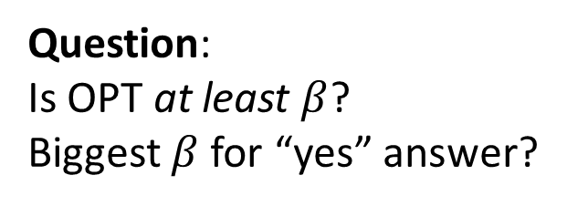

minimize
$$≥$$
subject to
$$+$$
$$+$$
Question:
Is OPT at least $β$?
Biggest $β$ for “yes” answer?
maximize
$$10y_{1}+6y_{2}$$
subject to
$$y_{1}+5y_{2}≤7$$
$$−y_{1}+2y_{2}≤1$$
$$3y_{1}−y_{2}≤5$$
$$y_{1},y_{2}≥0$$

Slide 22

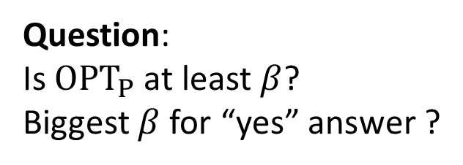


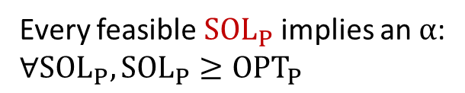


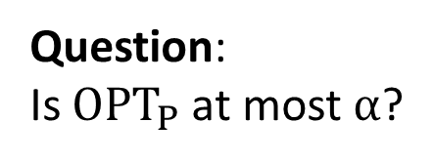




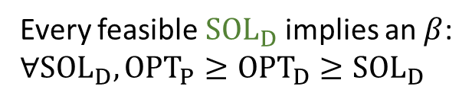
maximize
$$10y_{1}+6y_{2}$$
minimize
$$7x_{1}+x_{2}+5x_{3}$$
subject to
$$y_{1}+5y_{2}≤7$$
subject to
$$x_{1}−x_{2}+3x_{3}≥10$$
$$−y_{1}+2y_{2}≤1$$
$$5x_{1}+2x_{2}−x_{3}≥6$$
$$3y_{1}−y_{2}≤5$$
$$x_{1},x_{2},x_{3}≥0$$
$$y_{1},y_{2}≥0$$
Primal
Dual
Question: Is $OPT_{P}$ at most $α$?
Question: Is $OPT_{P}$ at least $β$?
Biggest $β$ for “yes” answer ?
Every feasible $SOL_{P}$ implies an $α$:
$∀SOL_{P}, SOL_{P}≥OPT_{P}$
Every feasible $SOL_{D}$ implies an $β$:
$∀SOL_{D}, OPT_{P}≥{OPT}_{D}≥SOL_{D}$

Slide 23
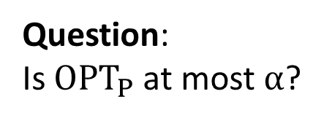






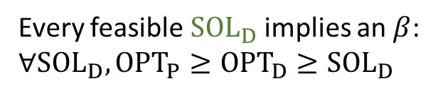

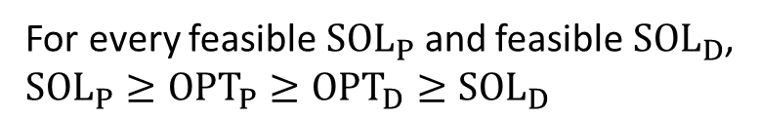
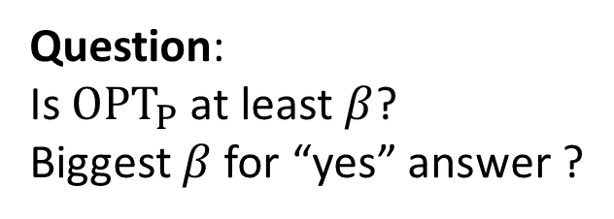

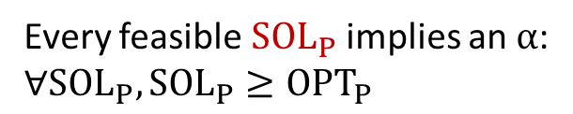

LP Duality
Primal
Dual
min
$${\vec{c}}^{T}\vec{x}$$
$$dual(Primal)$$
max
$${\vec{b}}^{T}\vec{y}$$
s.t.
$$A\vec{x}≥\vec{b}$$
s.t.
$$A^{T}\vec{y}≤\vec{c}$$
$$\vec{x}≥\vec{0}$$
$$dual(Dual)$$
$$\vec{y}≥\vec{0}$$
Question: Is $OPT_{P}$ at most $α$?
Question: Is $OPT_{P}$ at least $β$?
Biggest $β$ for “yes” answer ?
Every feasible $SOL_{P}$ implies an $α$:
$∀SOL_{P}, SOL_{P}≥OPT_{P}$
Every feasible $SOL_{D}$ implies an $β$:
$∀SOL_{D}, OPT_{P}≥{OPT}_{D}≥SOL_{D}$
Weak duality theorem:
$$Primal=dual(dual\left(Primal\right))$$
For every feasible $SOL_{P}$ and feasible $SOL_{D}$,
$SOL_{P}≥OPT_{P}≥OPT_{D}≥SOL_{D}$

Slide 24
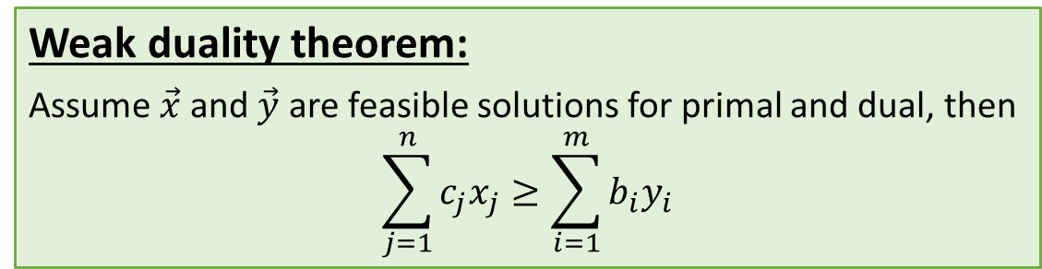






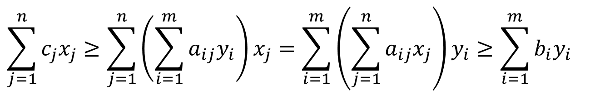
LP Duality
Primal
Dual
min
$${\vec{c}}^{T}\vec{x}$$
max
$${\vec{b}}^{T}\vec{y}$$
s.t.
$$A\vec{x}≥\vec{b}$$
s.t.
$$A^{T}\vec{y}≤\vec{c}$$
$${SOL}_{P}≥OPT_{P}≥{OPT}_{D}≥SOL_{D}$$
$$\vec{x}≥\vec{0}$$
$$\vec{y}≥\vec{0}$$
Weak duality theorem:
Assume $\vec{x}$ and $\vec{y}$ are feasible solutions for primal and dual, then $$\sum_{j=1}^{n}{c_{j}x_{j}}≥\sum_{i=1}^{m}{b_{i}y_{i}}$$
$$\sum_{j=1}^{n}{c_{j}x_{j}}≥\sum_{j=1}^{n}{\left(\sum_{i=1}^{m}{a_{ij}y_{i}}\right)x_{j}}=\sum_{i=1}^{m}{\left(\sum_{j=1}^{n}{a_{ij}x_{j}}\right)y_{i}}≥\sum_{i=1}^{m}{b_{i}y_{i}}$$

Slide 25
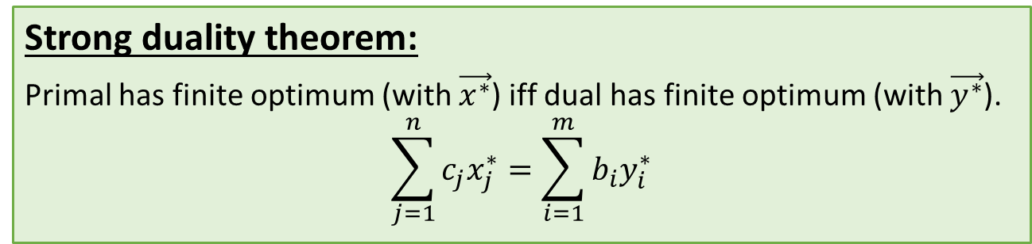
LP Duality
Primal
Dual
min
$${\vec{c}}^{T}\vec{x}$$
max
$${\vec{b}}^{T}\vec{y}$$
s.t.
$$A\vec{x}≥\vec{b}$$
s.t.
$$A^{T}\vec{y}≤\vec{c}$$
$${SOL}_{P}≥OPT_{P}≥{OPT}_{D}≥SOL_{D}$$
$$\vec{x}≥\vec{0}$$
$$\vec{y}≥\vec{0}$$
Weak duality theorem:
Assume $\vec{x}$ and $\vec{y}$ are feasible solutions for primal and dual, then $$\sum_{j=1}^{n}{c_{j}x_{j}}≥\sum_{i=1}^{m}{b_{i}y_{i}}$$
Strong duality theorem:
Primal has finite optimum (with $\vec{x^{∗}}$) iff dual has finite optimum (with $\vec{y^{∗}}$).
$$\sum_{j=1}^{n}{c_{j}x_{j}^{∗}}=\sum_{i=1}^{m}{b_{i}y_{i}^{∗}}$$

Slide 26

Performance of Ford-Fulkerson
FordFulkersonMaxFlow(G,s,t):
Initialize flow f to value 0
while (there is an augmenting path p in G_{f})
Augment flow f along path p
return f
$G=\left(V,E\right)$ with $\left|V\right|=n$ and $\left|E\right|=m$. Let $G$ be connected, so $m>n$.
The initialization process takes $O\left(m\right)$ time.
Each iteration takes $O\left(m\right)$ time.
How many iterations before termination?

Slide 27











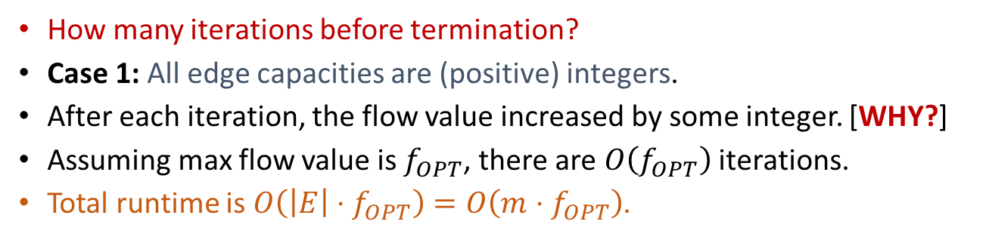





















Performance of Ford-Fulkerson
How many iterations before termination?
Case 1: All edge capacities are (positive) integers.
After each iteration, the flow value increased by some integer. [WHY?]
Assuming max flow value is $f_{OPT}$, there are $O\left(f_{OPT}\right)$ iterations.
Total runtime is $O\left(\left|E\right|⋅f_{OPT}\right)=O\left(m⋅f_{OPT}\right)$.
Is this bound tight?
$$x$$
$$v_{1}$$
$$x$$
$$x−1$$
$$v_{1}$$
$$x−1$$
$$v_{1}$$
$$x−1$$
$$x−2$$
$$v_{1}$$
$$x−1$$
$$x$$
1
1
1
2
1
$$s$$
1
$$t$$
$$s$$
1
$$t$$
$$s$$
1
$$t$$
$$s$$
1
$$t$$
1
1
1
1
2
$$x$$
$$x$$
$$x$$
$$x−1$$
$$x−1$$
$$x−1$$
$$x−1$$
$$x−2$$
$$v_{2}$$
$$v_{2}$$
$$v_{2}$$
$$v_{2}$$
$$\left|f\right|=1$$
$$\left|f\right|=2$$
$$\left|f\right|=3$$
$$\left|f\right|=⋯$$
$$f_{OPT}=2x$$

Slide 28
Performance of Ford-Fulkerson
How many iterations before termination?
Case 2: All edge capacities are (positive) rational numbers.
Similar to case one, as we can scale up to make capacities integers.
Total runtime still depends on the capacity values.

Slide 29
















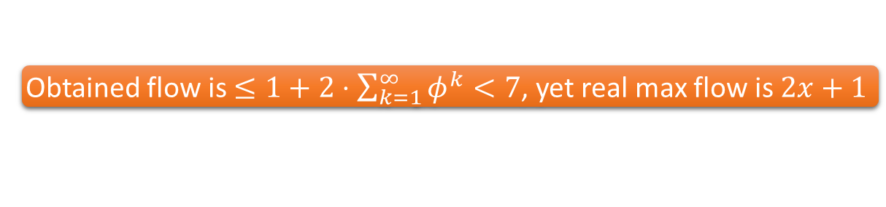





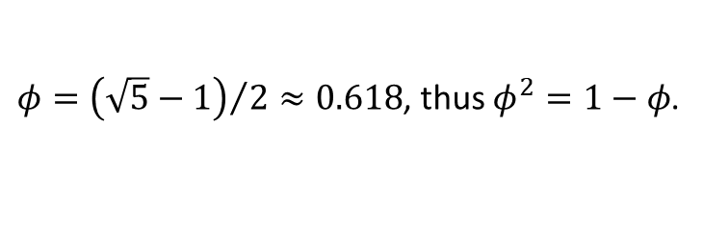



















Performance of Ford-Fulkerson
How many iterations before termination?
Case 3: Edge capacities are arbitrary (positive) real values.
Ford-Fulkerson algorithm might NEVER HALT!
Even worse, the algorithm will NOT CONVERGE to the max flow!
$φ={\left(\sqrt{5}−1\right)}/2≈0.618$, thus $φ^{2}=1−φ$.
$$x$$
$$s$$
$$x$$
$$s$$
$$s$$
$$x$$
$\left|f\right|+=1$
$$φ^{k−1}$$
$$1$$
$$φ^{k}$$
$\left|f\right|+=φ^{k}$
$$1$$
$$1$$
$$φ$$
$$1$$
$$1$$
$$φ$$
$$φ^{k+1}$$
$$1−φ^{k}$$
$$φ^{k}$$
$$φ^{k}$$
$$φ^{k}$$
$$x$$
$$x$$
$$x$$
$$t$$
$$t$$
$$t$$
Obtained flow is $≤1+2⋅\sum_{k=1}^{∞}{φ^{k}}<7$, yet real max flow is $2x+1$
$\left|f\right|+=φ^{k}$
$$s$$
$$s$$
$$s$$
$$\left|f\right|+=φ^{k+1}$$
$$\left|f\right|+=φ^{k+1}$$
$$φ^{k}$$
$$1$$
$$φ^{k+2}$$
$$φ^{k−1}$$
$$1−φ^{k+1}$$
$$φ^{k+2}$$
$$φ^{k+1}$$
$$1$$
$$φ^{k}$$
$$φ^{k+1}$$
$$φ^{k+1}$$
$$φ^{k+1}$$
$$φ^{k+1}$$
$$φ^{k}$$
$$t$$
$$t$$
$$t$$

Slide 30

Performance of Ford-Fulkerson
FordFulkersonMaxFlow(G,s,t):
Initialize flow f to value 0
while (there is an augmenting path p in G_{f})
Augment flow f along path p
return f
The initialization process takes $O\left(\left|E\right|\right)$ time.
Each iteration takes $O\left(\left|E\right|\right)$ time.
How many iterations before termination?
Case 1: All edge capacities are integers. Number of iterations can be $Θ\left(f_{OPT}\right)$.
Case 2: All edge capacities are rational numbers. Similar to case one.
Case 3: Edge capacities are arbitrary real values. Might never terminate, and not converge to optimal flow.
Better Performance?

Slide 31
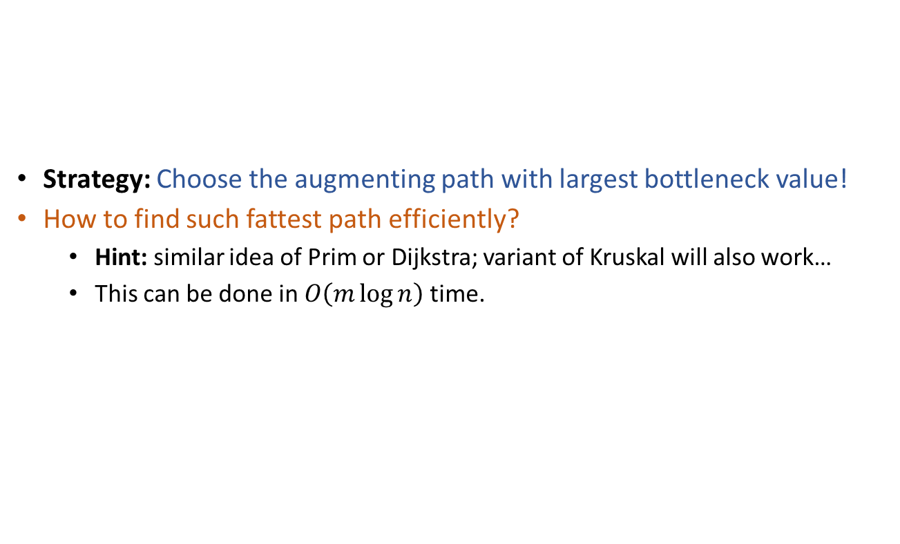
Improving the performance of Ford-Fulkerson Choose the “fattest” path
FordFulkersonMaxFlow(G,s,t):
Initialize flow f to value 0
while (there is an augmenting path p in G_{f})
Augment flow f along the fattest path p
return f
Strategy: Choose the augmenting path with largest bottleneck value!
How to find such fattest path efficiently?
Hint: similar idea of Prim or Dijkstra; variant of Kruskal will also work…
This can be done in $O\left(m\log{n}\right)$ time.

Slide 32
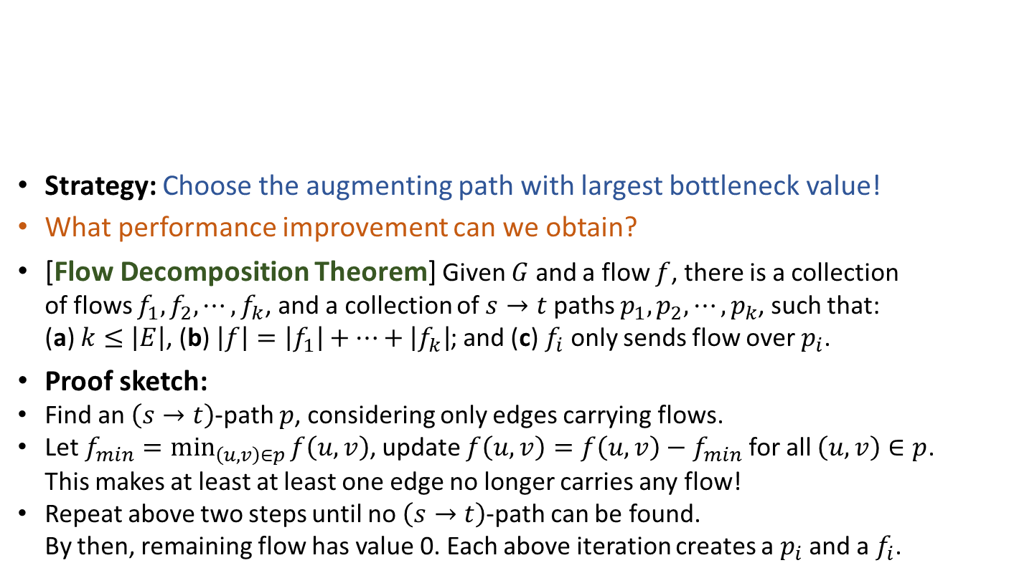
Improving the performance of Ford-Fulkerson Choose the “fattest” path
FordFulkersonMaxFlow(G,s,t):
Initialize flow f to value 0
while (there is an augmenting path p in G_{f})
Augment flow f along the fattest path p
return f
Strategy: Choose the augmenting path with largest bottleneck value!
What performance improvement can we obtain?
[Flow Decomposition Theorem] Given $G$ and a flow $f$, there is a collection of flows $f_{1},f_{2},⋯,f_{k}$, and a collection of $s→t$ paths $p_{1},p_{2},⋯,p_{k}$, such that: (a) $k≤\left|E\right|$, (b) $\left|f\right|=\left|f_{1}\right|+⋯+\left|f_{k}\right|$; and (c) $f_{i}$ only sends flow over $p_{i}$.
Proof sketch:
Find an $\left(s→t\right)$-path $p$, considering only edges carrying flows.
Let $f_{min}=\min_{\left(u,v\right)∈p}{f\left(u,v\right)}$, update $f\left(u,v\right)=f\left(u,v\right)−f_{min}$ for all $\left(u,v\right)∈p$. This makes at least at least one edge no longer carries any flow!
Repeat above two steps until no $\left(s→t\right)$-path can be found. By then, remaining flow has value 0. Each above iteration creates a $p_{i}$ and a $f_{i}$.
Any flow $f$ can be decomposed into at most $\left|E\right|$ $\left(s→t\right)$-path flows.

Slide 33
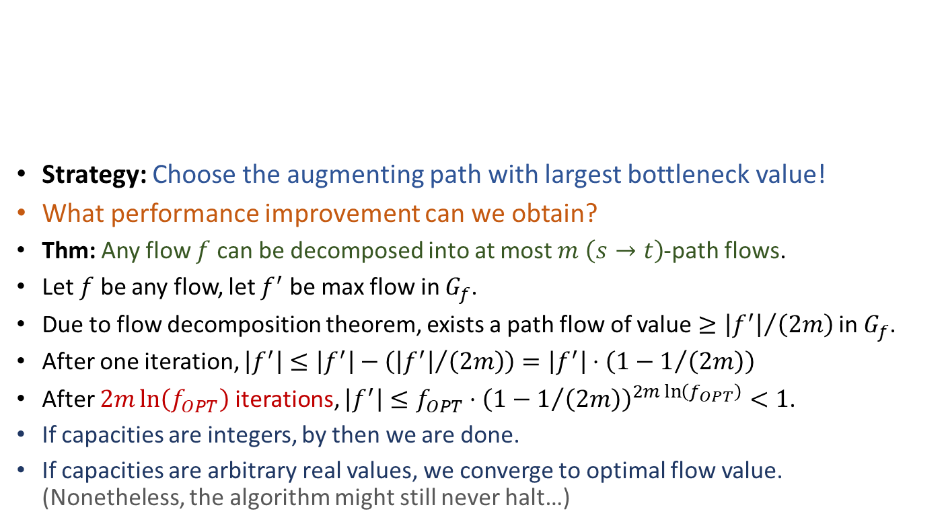
Improving the performance of Ford-Fulkerson Choose the “fattest” path
FordFulkersonMaxFlow(G,s,t):
Initialize flow f to value 0
while (there is an augmenting path p in G_{f})
Augment flow f along the fattest path p
return f
Strategy: Choose the augmenting path with largest bottleneck value!
What performance improvement can we obtain?
Thm: Any flow $f$ can be decomposed into at most $m$ $\left(s→t\right)$-path flows.
Let $f$ be any flow, let $f^{′}$ be max flow in $G_{f}$.
Due to flow decomposition theorem, exists a path flow of value $≥{\left|f^{′}\right|}/{\left(2m\right)}$ in $G_{f}$.
After one iteration, $\left|f^{′}\right|≤\left|f^{′}\right|−\left({\left|f^{′}\right|}/{\left(2m\right)}\right)=\left|f^{′}\right|⋅\left(1−1/{\left(2m\right)}\right)$
After $2m\ln\left(f_{OPT}\right)$ iterations, $\left|f^{′}\right|≤f_{OPT}⋅{\left(1−1/{\left(2m\right)}\right)}^{2m\ln\left(f_{OPT}\right)}<1$.
If capacities are integers, by then we are done.
If capacities are arbitrary real values, we converge to optimal flow value. (Nonetheless, the algorithm might still never halt…)

Slide 34
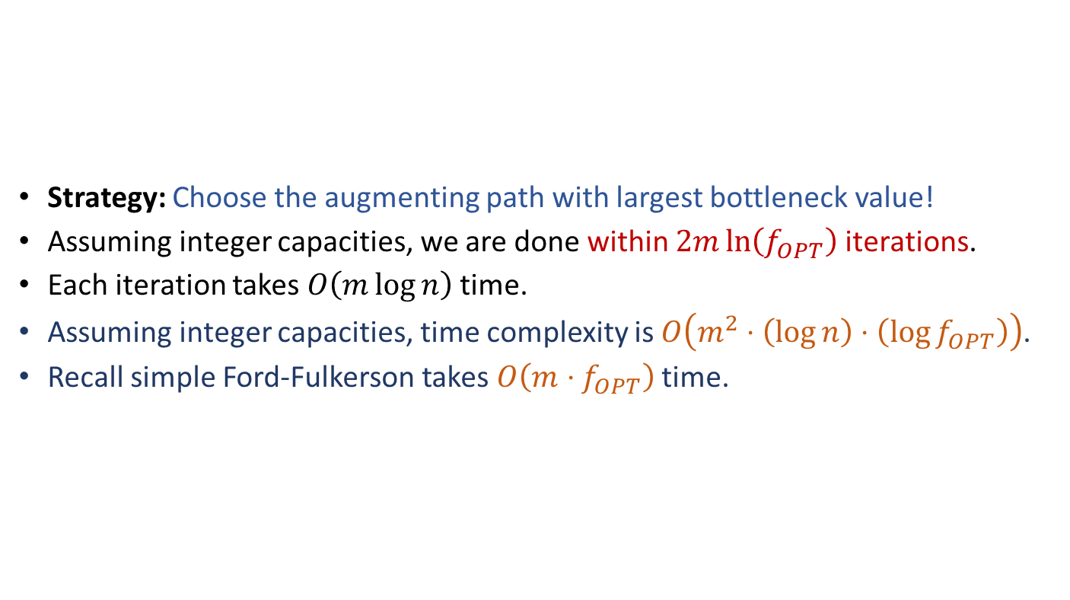
Improving the performance of Ford-Fulkerson Choose the “fattest” path
FordFulkersonMaxFlow(G,s,t):
Initialize flow f to value 0
while (there is an augmenting path p in G_{f})
Augment flow f along the fattest path p
return f
Strategy: Choose the augmenting path with largest bottleneck value!
Assuming integer capacities, we are done within $2m\ln\left(f_{OPT}\right)$ iterations.
Each iteration takes $O\left(m\log{n}\right)$ time.
Assuming integer capacities, time complexity is $O\left(m^{2}⋅\left(\log{n}\right)⋅\left(\log{f_{OPT}}\right)\right)$.
Recall simple Ford-Fulkerson takes $O\left(m⋅f_{OPT}\right)$ time.

Slide 35
Improving the performance of Ford-Fulkerson [Edmonds-Karp] Choose the “shortest” path
EdmondsKarpMaxFlow(G,s,t):
Initialize flow f to value 0
while (there is an augmenting path p in G_{f})
Augment flow f along the shortest path p
return f
Strategy: Choose the augmenting path with the smallest number of edges!
How to efficiently find such a path?
Easy, simply do BFS in the residual network.

Slide 36
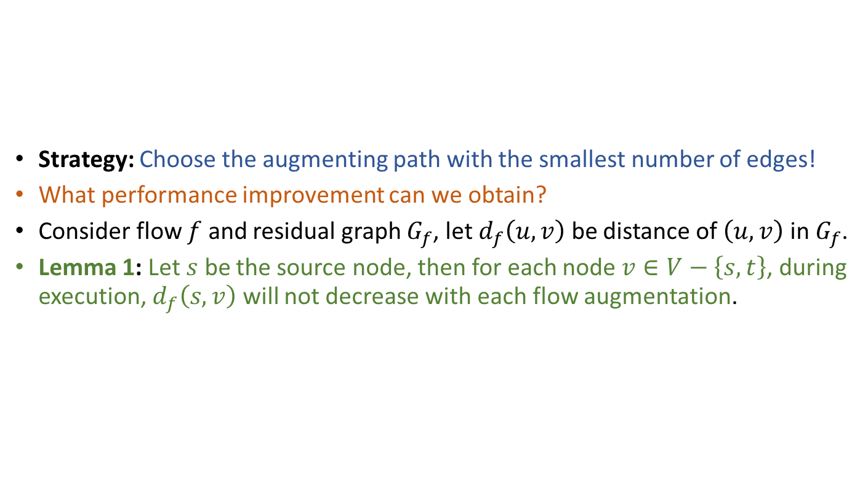
Improving the performance of Ford-Fulkerson [Edmonds-Karp] Choose the “shortest” path
EdmondsKarpMaxFlow(G,s,t):
Initialize flow f to value 0
while (there is an augmenting path p in G_{f})
Augment flow f along the shortest path p
return f
Strategy: Choose the augmenting path with the smallest number of edges!
What performance improvement can we obtain?
Consider flow $f$ and residual graph $G_{f}$, let $d_{f}\left(u,v\right)$ be distance of $\left(u,v\right)$ in $G_{f}$.
Lemma 1: Let $s$ be the source node, then for each node $v∈V−\left\{s,t\right\}$, during execution, $d_{f}\left(s,v\right)$ will not decrease with each flow augmentation.

Slide 37
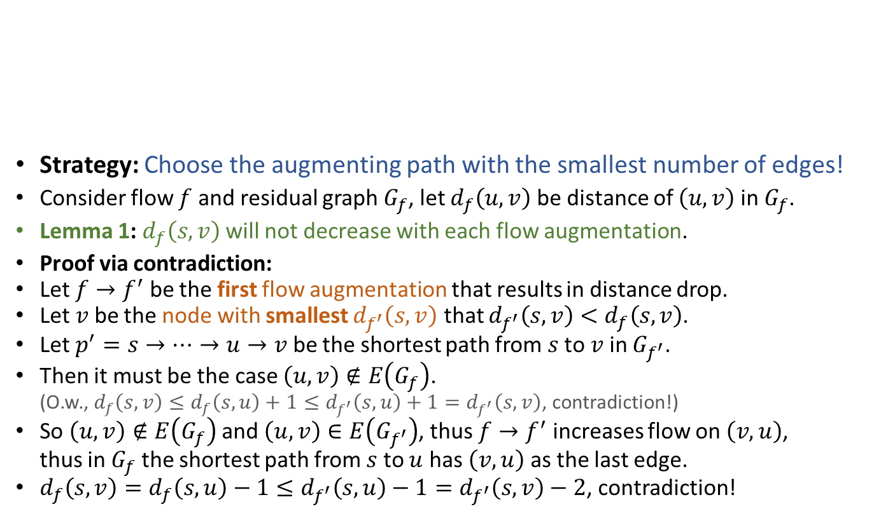
Improving the performance of Ford-Fulkerson [Edmonds-Karp] Choose the “shortest” path
EdmondsKarpMaxFlow(G,s,t):
Initialize flow f to value 0
while (there is an augmenting path p in G_{f})
Augment flow f along the shortest path p
return f
Strategy: Choose the augmenting path with the smallest number of edges!
Consider flow $f$ and residual graph $G_{f}$, let $d_{f}\left(u,v\right)$ be distance of $\left(u,v\right)$ in $G_{f}$.
Lemma 1: $d_{f}\left(s,v\right)$ will not decrease with each flow augmentation.
Proof via contradiction:
Let $f→f^{′}$ be the first flow augmentation that results in distance drop.
Let $v$ be the node with smallest $d_{f^{′}}\left(s,v\right)$ that $d_{f^{′}}\left(s,v\right)<d_{f}\left(s,v\right)$.
Let $p^{′}=s→⋯→u→v$ be the shortest path from $s$ to $v$ in $G_{f^{′}}$.
Then it must be the case $\left(u,v\right)∉E\left(G_{f}\right)$. (O.w., $d_{f}\left(s,v\right)≤d_{f}\left(s,u\right)+1≤d_{f^{′}}\left(s,u\right)+1=d_{f^{′}}\left(s,v\right)$, contradiction!)
So $\left(u,v\right)∉E\left(G_{f}\right)$ and $\left(u,v\right)∈E\left(G_{f^{′}}\right)$, thus $f→f^{′}$ increases flow on $\left(v,u\right)$, thus in $G_{f}$ the shortest path from $s$ to $u$ has $\left(v,u\right)$ as the last edge.
$d_{f}\left(s,v\right)=d_{f}\left(s,u\right)−1≤d_{f^{′}}\left(s,u\right)−1=d_{f^{′}}\left(s,v\right)−2$, contradiction!

Slide 38
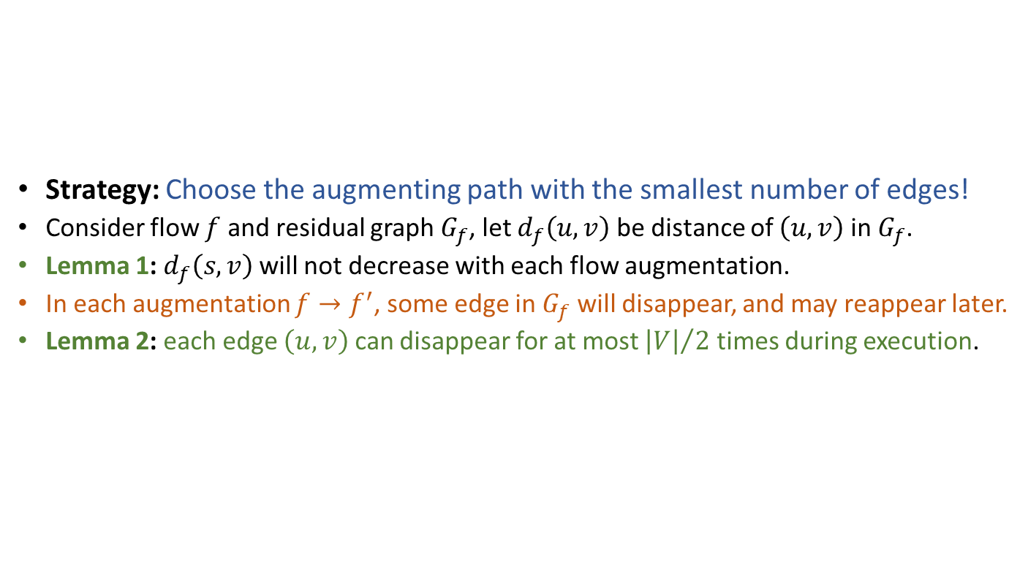
Improving the performance of Ford-Fulkerson [Edmonds-Karp] Choose the “shortest” path
EdmondsKarpMaxFlow(G,s,t):
Initialize flow f to value 0
while (there is an augmenting path p in G_{f})
Augment flow f along the shortest path p
return f
Strategy: Choose the augmenting path with the smallest number of edges!
Consider flow $f$ and residual graph $G_{f}$, let $d_{f}\left(u,v\right)$ be distance of $\left(u,v\right)$ in $G_{f}$.
Lemma 1: $d_{f}\left(s,v\right)$ will not decrease with each flow augmentation.
In each augmentation $f→f^{′}$, some edge in $G_{f}$ will disappear, and may reappear later.
Lemma 2: each edge $\left(u,v\right)$ can disappear for at most ${\left|V\right|}/2$ times during execution.

Slide 39

Improving the performance of Ford-Fulkerson [Edmonds-Karp] Choose the “shortest” path
EdmondsKarpMaxFlow(G,s,t):
Initialize flow f to value 0
while (there is an augmenting path p in G_{f})
Augment flow f along the shortest path p
return f
Strategy: Choose the augmenting path with the smallest number of edges!
In each augmentation $f→f^{′}$, some edge in $G_{f}$ will disappear, and may reappear later.
Lemma 2: each edge $\left(u,v\right)$ can disappear for at most ${\left|V\right|}/2$ times during execution.
Proof:
Consider an augmentation of $f$ that saturates $\left(u,v\right)$. (I.e., make $\left(u,v\right)$ disappear.)
Since augmenting path is a shortest path, $d_{f}\left(s,v\right)=d_{f}\left(s,u\right)+1$.
Later if augmentation of $f^{′}$ makes $\left(u,v\right)$ reappear, then $\left(v,u\right)∈E\left(G_{f^{′}}\right)$.
Therefore, $d_{f^{′}}\left(s,u\right)=d_{f^{′}}\left(s,v\right)+1$.
Recall previous lemma says $d_{f^{′}}\left(s,v\right)≥d_{f}\left(s,v\right)$, thus $d_{f^{′}}\left(s,u\right)≥d_{f}\left(s,u\right)+2$.
Each reappearance of $\left(u,v\right)$ increases $d\left(s,u\right)$ by at least 2, but $d\left(s,u\right)≤\left|V\right|$.

Slide 40

Improving the performance of Ford-Fulkerson [Edmonds-Karp] Choose the “shortest” path
EdmondsKarpMaxFlow(G,s,t):
Initialize flow f to value 0
while (there is an augmenting path p in G_{f})
Augment flow f along the shortest path p
return f
Strategy: Choose the augmenting path with the smallest number of edges!
What performance improvement can we obtain?
In each iteration, at least one of the $≤2\left|E\right|$ edges will disappear.
Lemma 2: each edge $\left(u,v\right)$ can disappear for at most ${\left|V\right|}/2$ times during execution.
The algorithm will terminate after $O\left(\left|V\right|⋅\left|E\right|\right)$ iterations.
The total runtime is $O\left(\left|V\right|⋅{\left|E\right|}^{2}\right)$.
Edmonds-Karp always halts with max-flow, regardless of actual capacities.

Slide 41

This is not the end…
James Orlin. Max flows in $O\left(nm\right)$ time, or better. STOC 2013.

Slide 42




This is not the end…
FOCS 2022 Best Paper
陈力
彭泱

Slide 43

Simple application of max-flow Maximum bipartite matching
A graph $G=\left(V,E\right)$ is bipartite if $V$ can be partitioned into $L$ and $R$, such that each edge connects a vertex in $L$ and a vertex in $R$.
A matching of a graph $G=\left(V,E\right)$ is a subset $M⊆E$, such that for each $v∈V$, at most one edge in $M$ is incident on $v$.
A maximum matching is a matching of maximum cardinality.
Problem: Find a maximum matching of a bipartite graph.

Slide 44



Simple application of max-flow Maximum bipartite matching
Problem: Find a maximum matching of a bipartite graph.
We can convert the problem to a max-flow problem!
Build a flow network $G^{′}=\left(V^{′},E^{′}\right)$ in the following way:
$V^{′}=V∪\left\{s,t\right\}$
$E^{′}=\left\{\left(s,u\right):u∈L\right\}∪\left\{\left(v,t\right):v∈R\right\}∪\left\{\left(u,v\right):\left(u,v\right)∈E\right\}$
Assign unit capacity to each edge in $E^{′}$
$$s$$
$$t$$

Slide 45



Simple application of max-flow Maximum bipartite matching
Problem A: Find a maximum matching of a bipartite graph $G=\left(V,E\right)$.
Problem B: Find a maximum flow in flow network $G^{′}=\left(V^{′},E^{′}\right)$.
A flow $f$ is integer-valued if $f\left(u,v\right)$ is an integer for all $\left(u,v\right)∈E^{′}$.
Lemma: (1) $∃$ matching $M$ of $G$ $⇒$ $∃$ flow $f$ of $G^{′}$ with $\left|f\right|=\left|M\right|$; (2) $∃$ integer-valued flow $f$ of $G^{′}$ $⇒$ $∃$ matching $M$ of $G$ with $\left|M\right|=\left|f\right|$.
$$s$$
$$t$$

Slide 46

Simple application of max-flow Maximum bipartite matching
Problem A: Find a maximum matching of a bipartite graph $G$.
Problem B: Find a maximum flow in flow network $G^{′}$.
Lemma: (1) $∃$ matching $M$ of $G$ $⇒$ $∃$ flow $f$ of $G^{′}$ with $\left|f\right|=\left|M\right|$; (2) $∃$ integer-valued flow $f$ of $G^{′}$ $⇒$ $∃$ matching $M$ of $G$ with $\left|M\right|=\left|f\right|$.
Proof of part (1):
For each $\left(u,v\right)∈M$, define $f\left(s,u\right)=f\left(u,v\right)=f\left(v,t\right)=1$.
For each $\left(u,v\right)∈E^{′}−M$, define $f\left(u,v\right)=0$.
Easy to verify $f$ is feasible, and $\left|M\right|=\left|f\right|$.
$$s$$
$$t$$

Slide 47

Simple application of max-flow Maximum bipartite matching
Problem A: Find a maximum matching of a bipartite graph $G$.
Problem B: Find a maximum flow in flow network $G^{′}$.
Lemma: (1) $∃$ matching $M$ of $G$ $⇒$ $∃$ flow $f$ of $G^{′}$ with $\left|f\right|=\left|M\right|$; (2) $∃$ integer-valued flow $f$ of $G^{′}$ $⇒$ $∃$ matching $M$ of $G$ with $\left|M\right|=\left|f\right|$.
Proof of part (2):
Let $M=\left\{\left(u,v\right):u∈L,v∈R,f\left(u,v\right)>0\right\}$.
Need to prove $M$ is a matching and $\left|M\right|=\left|f\right|$.
$M$ is a matching: Pick $\left(u,v\right)∈M$. Since $c\left(u,v\right)=1$, $f\left(u,v\right)>0$ and $f$ is integer-valued, $f\left(u,v\right)=f\left(s,u\right)=1$. Therefore, $\left(u,v^{′}\right)∉M$ for all $v^{′}≠v$. Similarly, $\left(u^{′},v \right)∉M$ for all $u^{′}≠u$.
$\left|M\right|=\left|f\right|$: Consider cut $\left(L∪\left\{s\right\},R∪\left\{t\right\}\right)$ of $G^{′}$, net flow across the cut is $\left|M\right|$.

Slide 48

Simple application of max-flow Maximum bipartite matching
Problem A: Find a maximum matching of a bipartite graph $G=\left(V,E\right)$.
Problem B: Find a maximum flow in flow network $G^{′}=\left(V^{′},E^{′}\right)$.
A flow $f$ is integer-valued if $f\left(u,v\right)$ is an integer for all $\left(u,v\right)∈E^{′}$.
Lemma: (1) $∃$ matching $M$ of $G$ $⇒$ $∃$ flow $f$ of $G^{′}$ with $\left|f\right|=\left|M\right|$; (2) $∃$ integer-valued flow $f$ of $G^{′}$ $⇒$ $∃$ matching $M$ of $G$ with $\left|M\right|=\left|f\right|$.
Observation: If capacities of $G^{′}$ are integers, Ford-Fulkerson’s method always finds an integer-valued flow.
Theorem: If we use Ford-Fulkerson’s method to find max-flow, then size of max-matching in $G$ equals value of max-flow in $G^{′}$.
Use max-flow algorithm to solve max-bipartite-matching problem!

Slide 49


Reading
[CLRS] Ch.26 (26.1-26.3)
Optional reading: [DPV] Ch.7 (7.1-7.4); [Erickson v1] Ch.10

